Slide 1

Predicting The Recurrence of Breast Cancer Using Predictive Models
Tareq Haboukh
BAN210 - Final Report

Slide 2
The Goal of the Analysis
This analysis and the training of predictive models is aimed to help Oncologists (Cancer doctors) determine whether a cancer is recursive or not.
Four Different Predictive Models
Decision Tree
Gradient Boosting
Regression
Neural Network

Slide 3
The Gradient Boosting Model
Gradient Boosting performed the best in predicting the class of a cancer in the validation dataset.
Accuracy 75.8%
Precision 66.7%
Average Square Error (Train 9%, Validation 19%)
Misclassification Rate (Train 9%, Validation 22.9%)

Slide 4
The Breast Cancer Dataset
The dataset can be found on the UCI Machine learning repository. It contains 10 attributes, 285 Records (200 No recurrence events, 85 recurrence events).
Attribute | Values
Class | no-recurrence-events, recurrence-events.
Age | 10-19, 20-29, 30-39, 40-49, 50-59, 60-69, 70-79, 80-89, 90-99.
Menopause | lt40, ge40, premeno.
Tumor-Size | 0-4, 5-9, 10-14, 15-19, 20-24, 25-29, 30-34, 35-39, 40-44, 45-49, 50-54, 55-59.
Inv-Nodes | 0-2, 3-5, 6-8, 9-11, 12-14, 15-17, 18-20, 21-23, 24-26, 27-29, 30-32, 33-35, 36-39.
Node-Caps | yes, no.
Deg-Malig | 1, 2, 3.
Breast | left, right.
Breast-Quad | left-up, left-low, right-up, right-low, central.
Irradiat | yes, no.

Slide 5
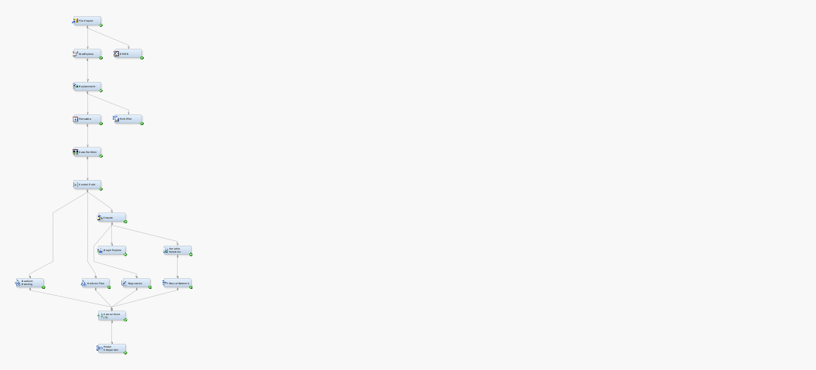
SAS Enterprise Miner
Analysis Five Stages
Import Dataset
Exploratory Data Analysis
Data Manipulation
Predictive Model Training
Predictive Model Comparison

Slide 6
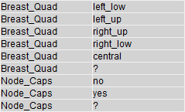
Data Manipulation
The Dataset has missing values in both Breast_Quad & Node_Caps, an “?” is found as an extra level.
Values Replaced with Null values and then imputed using Tree Surrogate method.
Imputation happened at the Regression and Neural Network Nodes.
The Dataset is split 70% fir Training ad 30% for Validation.

Slide 7
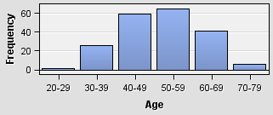
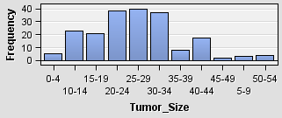
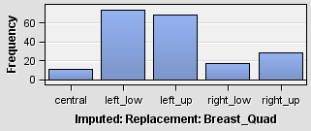
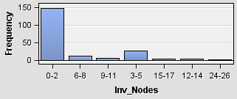
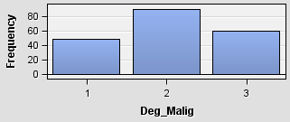
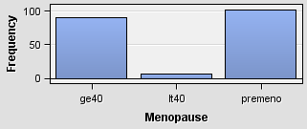
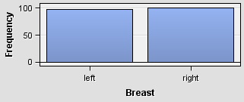
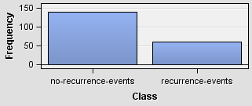
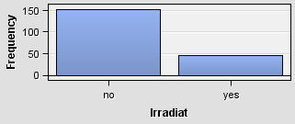
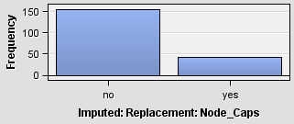
Exploratory Data Analysis
Age & Tumor_Size follow a Random Distribution
Inv_Nodes most cases in bin 0-2
No signs of anomalies in the dataset

Slide 8
The Predictive models

Slide 9
Gradient Boosting
Model Performance:
Accuracy 75.8%
Average Squared Error
Train 9.2% - Valid 19.7%
Misclassification Rate
Train 9.5% - Valid 22.9%

Slide 10
Decision Trees
Model Performance:
Accuracy 73.5%
Average Squared Error
Train 17.7% - Valid 18.5%
Misclassification Rate
Train 24.2% - Valid 26.4%

Slide 11
Regression
Model Performance:
Accuracy 73.5%
Average Squared Error
Train 17.6% - Valid 18.4%
Misclassification Rate
Train 24.2% - Valid 26.4%

Slide 12
Neural Network
Model Performance:
Accuracy 75.8%
Average Squared Error
Train 14.4% - 19.6 Valid %
Misclassification Rate
Train 20.2% - Valid 24.1%

Slide 13
Thank You

